Slide 1
Introduction to MATLAB
Simon O’Keefe
Non-Standard Computation Group
sok@cs.york.ac.uk

Slide 2
Content
An introduction to MATLAB
The MATLAB interfaces
Variables, vectors and matrices
Using operators
Using Functions
Creating Plots

Slide 3
1 Introduction to MATLAB
What is MATLAB?
  MATLAB provides a language and environment for numerical computation, data analysis, visualisation and algorithm development
  MATLAB provides functions that operate on
    Integer, real and complex numbers
    Vectors and matrices
    Structures

Slide 4
1 MATLAB Functionality
  Built-in Functionality includes
    Matrix manipulation and linear algebra
    Data analysis
    Graphics and visualisation
    …and hundreds of other functions ☺
  Add-on toolboxes provide*
    Image processing
    Signal Processing
    Optimization
    Genetic Algorithms
    …* but we have to pay for these extras ☹

Slide 5
1 MATLAB paradigm
MATLAB is an interactive environment
  Commands are interpreted one line at a time
  Commands may be scripted to create your own functions or procedures
Variables are created when they are used
Variables are typed, but variable names may be reused for different types
Basic data structure is the matrix
  Matrix dimensions are set dynamically
Operations on matrices are applied to all elements of a matrix at once
  Removes the need for looping over elements one by one!
  Makes for fast & efficient programmes

Slide 6
1 Starting and stopping
To Start
  On Windows XP platform select
  Start->Programs->Maths and Stats->
  MATLAB->MATLAB_local->R2007a->MATLAB R2007a
  For access to the Genetic Algorithms and Stats toolboxes, you must use R2007b on Windows
    MATLAB runs on Linux quite happily but we do not have toolbox licences
To stop (nicely)
  Select File -> Exit MATLAB
  Or type quit in the MATLAB command window

Slide 7
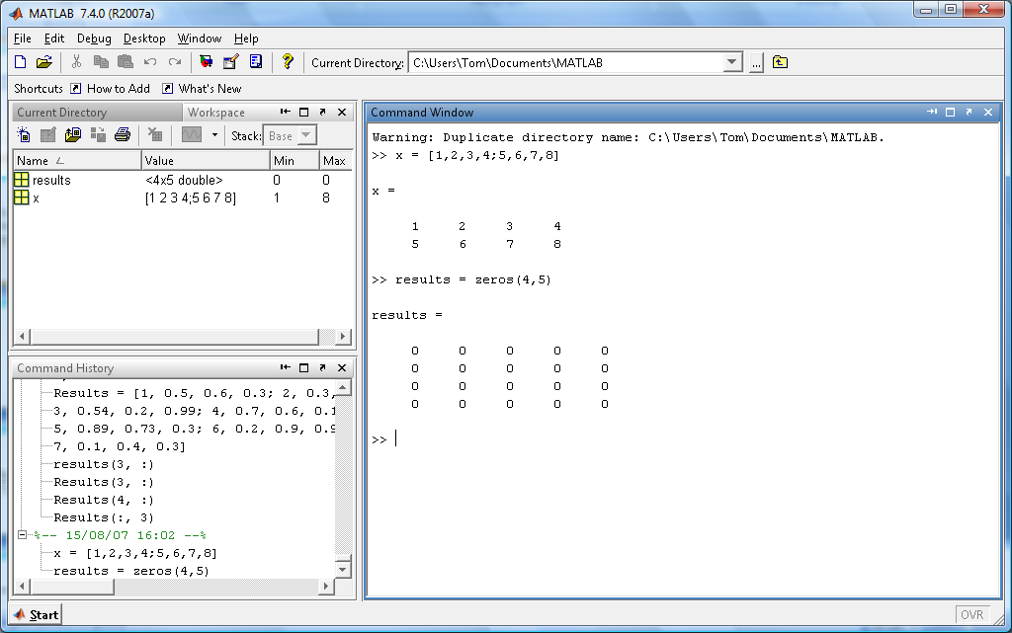
1 The MATLAB interfaces
Workspace
Command Window
Command History

Slide 8
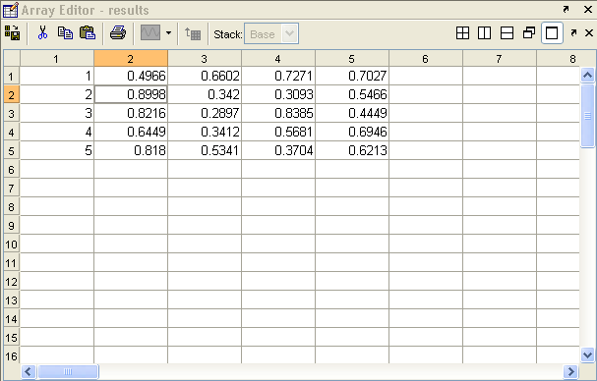
1 Window Components
  Command Prompt – MATLAB commands are entered here.
  Workspace – Displays any variables created (Matrices, Vectors, Singles, etc.)
  Command History - Lists all commands previously entered.
Double clicking on a variable in the Workspace will open an Array Editor. This will give you an Excel-like view of your data.
Notes:
The array editor view will be updated as you change variables so it may be useful to keep this open with the data you are working on....

Slide 9
1 The MATLAB Interface
Pressing the up arrow in the command window will bring up the last command entered
  This saves you time when things go wrong
If you want to bring up a command from some time in the past type the first letter and press the up arrow.
The current working directory should be set to a directory of your own
Notes:
If you enter a command slightly wrong you can press the up arrow to correct it,
You can scroll through what is entered in the past by continuing to press up.
You can type the first few letters of the command and press the up arrow to jump more quickly to a command.

Slide 10
2 Variables, vectors and matrices

Slide 11
2.1 Creating Variables
Variables
  Names
    Can be any string of upper and lower case letters along with numbers and underscores but it must begin with a letter
    Reserved names are IF, WHILE, ELSE, END, SUM, etc.
    Names are case sensitive
  Value
    This is the data the is associated to the variable; the data is accessed by using the name.
  Variables have the type of the last thing assigned to them
    Re-assignment is done silently – there are no warnings if you overwrite a variable with something of a different type.
Notes:
The value of the variable is accessed through it’s name... You could think of a variable as a box with a label (the name), inside it you put your data and then you can access this data by looking up the name.
Can not use reserved names: an error saying “the expression to the left of the equals sign is not a valid target”.
Names are case sensitive so Rob is not the same as rob.

Slide 12


2.1 Single Values
Singletons
  To assign a value to a variable use the equal symbol ‘=‘
    >> A = 32
  To find out the value of a variable simply type the name in
Notes:
If you see text in brown with >> this is code that you would enter into MATLAB or an example of the structure of how to type it. This should be clear but i will point out.....
Here you have the element as you would enter it into excel and the equivalent thing in matlab.

Slide 13

2.1 Single Values
To make another variable equal to one already entered
  >> B = A
The new variable is not updated as you change the original value
Note: using ; suppresses output
Notes:
Unlike in Excel variables are not linked, ie when you enter =A1 in excel and change the value in A1 the copied value will also change... This does not happen in matlab variables are assigned the other variables only when you type the command.
There isnt an example of it here but ; stops matlab displaying the result after a command, if I was to type A = 15; then the operation will be carried out but A = 15 will not be displayed when it is complete.

Slide 14
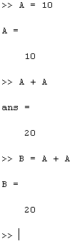
2.1 Single Values
The value of two variables can be added together, and the result displayed…
  >> A = 10
  >> A + A
…or the result can be stored in another variable
  >> A = 10
  >> B = A + A
Notes:
The value of the variable is accessed through it’s name..... Adding A to A adds the values in the variable A (here 10) therefore the result is 20
the result can be stored in a new variable, B, which you can see now has the value 20

Slide 15
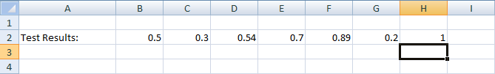
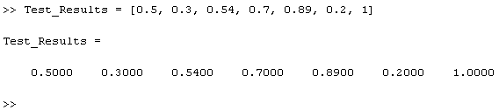
2.1 Vectors
A vector is a list of numbers
  Use square brackets [] to contain the numbers
To create a row vector use ‘,’ to separate the content
Notes:
Here you can see the vector as it would be entered in Excel and the equivalent in MATLAB.
This is the same as assigning the single values above, using the equals sign to assign the data to the variable name. This time however we need to tell matlab how to interpret what we enter, the comma tells it this, instructing matlab to start a new column after each number, forming a row.
The vector can be as long as you want (up to a very large number)

Slide 16
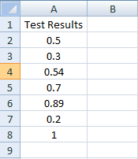
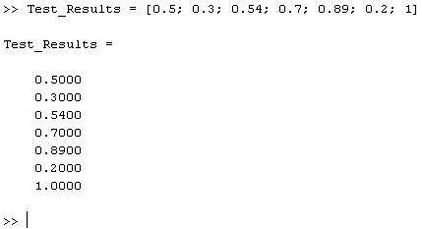
2.1 Vectors
  To create a column vector use ‘;’ to separate the content
Notes:
And this time we use the semi-colon to tell matlab to start a new row after each value, forming a column.

Slide 17
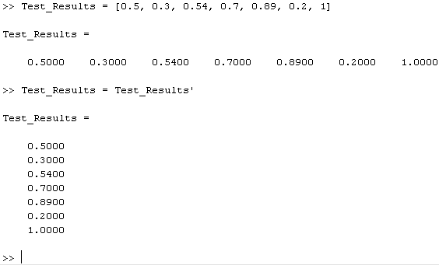
2.1 Vectors
A row vector can be converted into a column vector by using the transpose operator ‘
Notes:
The order of the values will stay, so the first will be the first and the second the second after transposing

Slide 18
2.1 Matrices
A MATLAB matrix is a rectangular array of numbers
  Scalars and vectors are regarded as special cases of matrices
  MATLAB allows you to work with a whole array at a time

Slide 19
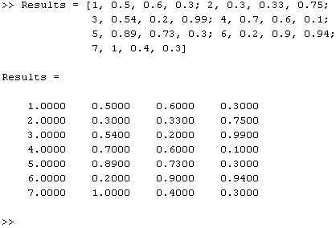
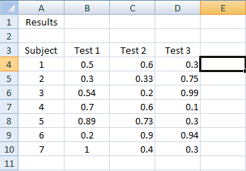
2.1 Matrices
You can create matrices (arrays) of any size using a combination of the methods for creating vectors
List the numbers using ‘,’ to separate each column and then ‘;’ to define a new row
Notes:
**NOTES***
You can also type and copy data into the array editor

Slide 20
2.1 Matrices
You can also use built in functions to create a matrix
  >> A = zeros(2, 4)
  creates a matrix called A with 2 rows and 4 columns containing the value 0
  >> A = zeros(5) or >> A = zeros(5, 5)
  creates a matrix called A with 5 rows and 5 columns
You can also use:
  >> ones(rows, columns)
  >> rand(rows, columns)
Note: MATLAB always refers to the first value as the number of Rows then the second as the number of Columns
Notes:
Obviously you could create vectors using these functions by setting either the row or column number to 0.....
You can initialise a matrix to, say, 5 by using ones(2,2) * 5
Rand takes numbers from a Gaussian distribution with unit mean and variance....

Slide 21
2.1 Clearing Variables
You can use the command “clear all” to delete all the variables present in the workspace
You can also clear specific variables using:
  >> clear Variable_Name

Slide 22
2.2 Accessing Matrix Elements
An Element is a single number within a matrix or vector
To access elements of a matrix type the matrices’ name followed by round brackets containing a reference to the row and column number:
  >> Variable_Name(Row_Number, Column_Number)
NOTE: In Excel you reference a value by Column, Row. In MATLAB you reference a value by Row, Column
Notes:
Here is the structure of how to type the command in... So for example to access element 3, 4 from a matrix called ‘results’ you replace these so this will read results(3,4) (NEXT SLIDE)

Slide 23
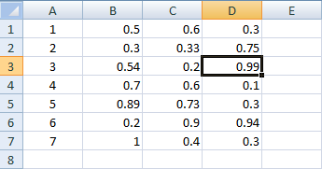
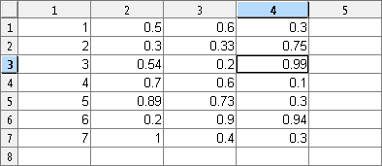
2.2 Accessing Matrix Elements
1st
2nd
Excel
MATLAB
2nd
1st
To access Subject 3’s result for Test 3
  In Excel (Column, Row):
  D3
  In MATLAB (Row, Column):
  >> results(3, 4)
Notes:
Here I have double clicked on the matrix name in the workspace and have brought up the array editor...
As I just said you refer to the row first in matlab, here is an example. In Excel you would refer to subject 3’s test 3 results as D3 (it’s Column letter then it’s Row number)... In matlab you enter the matrix’s name along with a reference to the Row then Column number.
Just as when we assigned A = B or B = A+A you could also assign this element to a new variable B = results(3,4) so B would equal 0.99

Slide 24
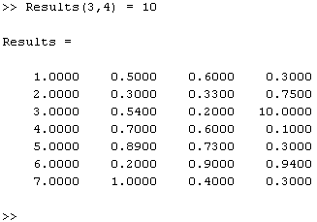
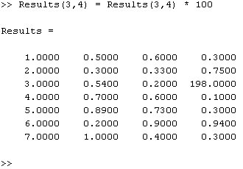
2.2 Changing Matrix Elements
The referenced element can also be changed
  >> results(3, 4) = 10
  or
  >> results(3,4) = results(3,4) * 100
Notes:
So here, we overwrite the value that we previously looked up, in the first example we have overwritten it with 10.... And in the second value we have looked up the original value, multiplied it by 100 and then put it back into the matrix

Slide 25
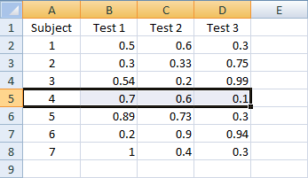
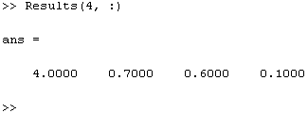
2.2 Accessing Matrix Rows
You can also access multiple values from a Matrix using the : symbol
  To access all columns of a row enter:
  >> Variable_Name(RowNumber, :)
Notes:
To extend this to extracting multiple values from a matrix we can use the colon symbol to refer to all... So results(4, :) gives us all of row 4 from results.

Slide 26
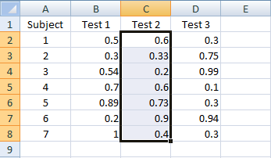
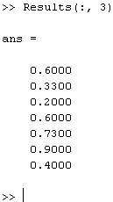
2.2 Accessing Matrix Columns
To access all rows of a column
  >> Variable_Name(:, ColumnNumber)
Notes:
And, similarly, results(:, 3) gives us all of the third column of results

Slide 27
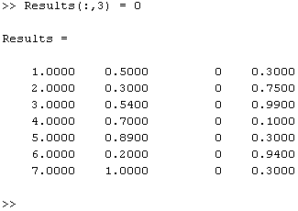
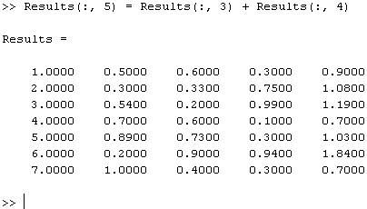
2.2 Changing Matrix Rows or Columns
These reference methods can be used to change the values of multiple matrix elements
To change all of the values in a row or column to zero use
  >> results(:, 3) = 0 >> results(:, 5) = results(:, 3) + results(:, 4)
Notes:
You can use this to overwrite a row or column, results(:, 3) = 0 sets all rows in column 3 to be 0..... You could also access all rows in columns 3 and 4 and add them together... Inserting the result into a new, 5th column...

Slide 28
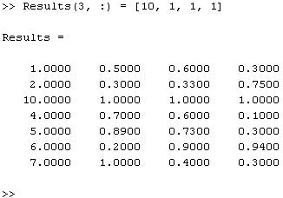
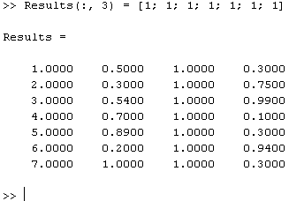
2.2 Changing Matrix Rows or Columns
To overwrite a row or column with new values
  >> results(3, :) = [10, 1, 1, 1]
  >> results(:, 3) = [1; 1; 1; 1; 1; 1; 1]
NOTE: Unless you are overwriting with a single value the data entered must be of the same size as the matrix part to be overwritten.
Notes:
Instead of setting all of a column or row to 0 you can overwrite it with a new row or column.... As long as they are the same size.... You need to use the commas and semi-colons to tell matlab how to interpret the new data.

Slide 29
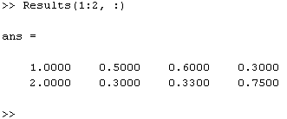
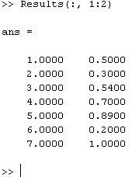
2.2 Accessing Multiple Rows, Columns
  To access consecutive Rows or Columns use : with start and end points:
  Multiple Rows:
  >> Variable_Name(start:end, :)
  Multiple Columns:
  >> Variable_Name(:, start:end)
Notes:
You can access multiple rows and columns using the colon symbol with start and end points, instead of accessing all of the data matlab will access the rows or columns from the start point up to the ending points. So in the first example you can read this as access rows 1 to 2 and all columns of results
Explain what 1:5 is doing (ie it creates a vector containing values from 1,2,3,4,5)
A(2:3, 2:3)
= [2 3
6 7]

Slide 30
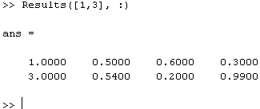
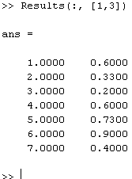
2.2 Accessing Multiple Rows, Columns
To access multiple non consecutive Rows or Columns use a vector of indexes (using square brackets [])
  Multiple Rows:
    >>Variable_Name([index1, index2, etc.], :)
  Multiple Columns:
    >>Variable_Name(:, [index1, index2, etc.])
Notes:
Instead of accessing all the rows or columns between a start and end point you can also instruct matlab to access multiple lines by giving it a vector of row or column numbers. So if you want to access all of rows 1 and 3 from results you would enter this.
You can combine these so that you can access the first 2 rows of the first 2 columns etc... (results([1,2], [1,3])

Slide 31
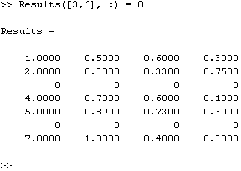
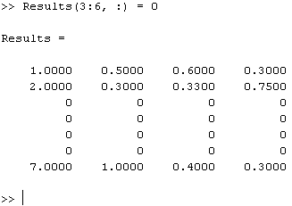
2.2 Changing Multiple Rows, Columns
The same referencing can be used to change multiple Rows or Columns
>> results([3,6], :) = 0
>> results(3:6, :) = 0
Notes:
This is the same as when accessing single rows.... The first example shows rows 3 and 6 being set to 0 .... and the second all rows from 3 to 6.
As before you can overwrite the data with new columns or rows.... results([3,6], :) = [3, 1, 1, 1; 6, 2, 2, 2]

Slide 32
2.3 Copying Data from Excel
MATLAB’s Array Editor allows you to copy data from an Excel spreadsheet in a very simple way
  In Excel select the data and click on copy
  Double click on the variable you would like to store the data in
    This will open the array editor
  In the Array Editor right click in the first element and select “Paste Excel Data”

Slide 33
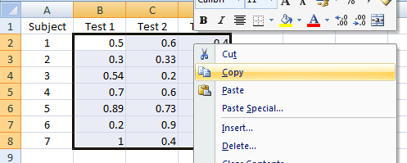
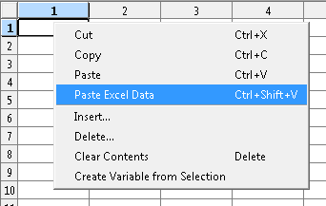
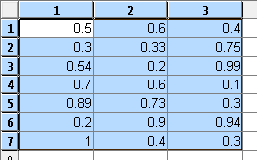
2.3 Copying Data from Excel

Slide 34
2.4 The colon operator
The colon : is actually an operator, that generates a row vector
This row vector may be treated as a set of indices when accessing a elements of a matrix
The more general form is
  [start:stepsize:end]
  >> [11:2:21]
  11 13 15 17 19 21
  >>
Stepsize does not have to be integer (or positive)
  >> [22:-2.07:11]
  22.00 19.93 17.86 15.79 13.72 11.65
  >>

Slide 35
2.4 Concatenation
The square brackets [] are the concatenation operator.
So far, we have concatenated single elements to form a vector or matrix.
The operator is more general than that – for example we can concatenate matrices (with the same dimension) to form a larger matrix

Slide 36
2.4 Saving and Loading Data
Variables that are currently in the workspace can be saved and loaded using the save and load commands
MATLAB will save the file in the Current Directory
To save the variables use
  >> save File_Name [variable variable …]
To load the variables use
  >> load File_Name [variable variable …]

Slide 37
3 More Operators

Slide 38
3.1 Mathematical Operators
Mathematical Operators:
    Add: +
    Subtract: -
    Divide: ./
    Multiply: .*
    Power: .^ (e.g. .^2 means squared)
You can use round brackets to specify the order in which operations will be performed
Note that preceding the symbol / or * or ^ by a ‘.’ means that the operator is applied between pairs of corresponding elements of vectors of matrices
Notes:
All the operators are straight forward except for divide, multiple and power which have a full stop in front of them, this is because the divide and multiple operator without the . does something different which you most likely will not use.
And you can specify the order using brackets, so here A is multipled by A BEFORE 10 is subtracted

Slide 39
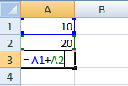
3.1 Mathematical Operators
Simple mathematical operations are easy in MATLAB
The command structure is:
    >> Result_Variable =
    Variable_Name1 operator Variable_Name2
  E.g. To add two numbers together:
      Excel: MATLAB:
        >> C = A + B
        >> C = (A + 10) ./ 2
Notes:
So assigning the result value to a variable (using the =) apply this operator to both of these variables, just like you would write the sum or multiplication down.
Using this structure you can apply these operators to a matrix, a single value or a reference to a part of a matrix and you could also assign the output to a part of a matrix

Slide 40
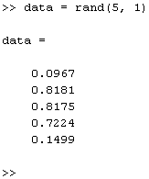

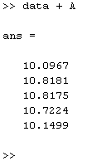
3.1 Mathematical Operators
You can apply single values to an entire matrix
  E.g.
  >> data = rand(5,1)
  >> A = 10
  >> results = data + A
Notes:
So for example you can add 10 to every element in a vector or matrix
You can see that it is the same command structure as before

Slide 41
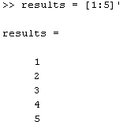
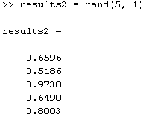
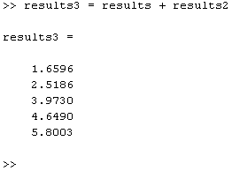
3.1 Mathematical Operators
Or, if two matrices/vectors are the same size, you can perform these operations between them
  >> results = [1:5]’
  >> results2 = rand(5,1)
  >> results3 = results + results2
Notes:
And you can add two vectors together if they are the same size.
Notice that I have used the colon as a shorthand to writing 1,2,3,4 etc...
When applied to matrices or vectors the values of matching positions from each matrix are added together. so the first is added with the first, second with second etc...

Slide 42
3.1 Mathematical Operators
Combining this with methods from Accessing Matrix Elements gives way to more useful operations
  >> results = zeros(3, 5)
  >> results(:, 1:4) = rand(3, 4)
  >> results(:, 5) = results(:, 1) + results(:, 2) + results(:, 3) + results(:, 4)
  or
  >> results(:, 5) = results(:, 1) .* results(:, 2) .* results(:, 3) .* results(:, 4)
  NOTE: There is a simpler way to do this using the Sum and Prod functions, this will be shown later.
Notes:
Here results is set up to be a
As well as putting the results into a new column of the matrix they could be put into a new variable

Slide 43
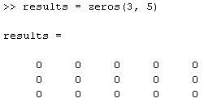
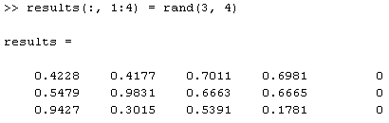
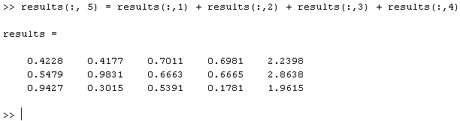
3.1 Mathematical Operators
  >> results = zeros(3, 5)
  >> results(:, 1:4) = rand(3, 4)
  >> results(:, 5) = results(:, 1) + results(:, 2) + results(:, 3) + results(:, 4)
Notes:
First I create an empty matrix with 3 rows and 5 columns... I then set the first 4 columns to random values.... And then sum those and insert the value into the 5th column

Slide 44
3.1 Mathematical Operators
You can perform operations on a matrix - you are very likely to use these
  Matrix Operators:
    Matrix Multiply: *
    Matrix Right Division: /
Example:

Slide 45
3.1 Operation on matrices
Multiplication of matrices with * calculates inner products between rows and columns
To transpose a matrix, use ‘
det(A) calculates the determinant of a matrix A
inv(A) calculates the inverse of a matrix A
pinv(A) calculates the pseudo-inverse of A
…and so on

Slide 46
3.2 Logical Operators
  You can use Logical Indexing to find data that conforms to some limitations
  Logical Operators:
    Greater Than: >
    Less Than: <
    Greater Than or Equal To: >=
    Less Than or Equal To: <=
    Is Equal: ==
    Not Equal To: ~=

Slide 47
3.2 Logical Indexing
For example, you can find data that is above a certain limit:
  >> r = results(:,1)
  >> ind = r > 0.2
  >> r(ind)
ind is the same size as r and contains zeros (false) where the data does not fit the criteria and ones (true) where it does, this is called a Logical Vector.
r(ind) then extracts the data where ones exist in ind

Slide 48
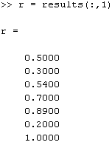
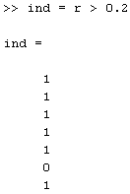

3.2 Logical Indexing
  >> r = results(:,1)
  >> ind = r > 0.2
  >> r(ind)

Slide 49
3.3 Boolean Operators
  Boolean Operators:
    AND: &
    OR: |
    NOT: ~
Connects two logical expressions together

Slide 50
3.3 Boolean Operators
Using a combination of Logical and Boolean operators we can select values that fall within a lower and upper limit
  >> r = results(:,1)
  >> ind = r > 0.2 & r <= 0.9
  >> r(ind)
More later...

Slide 51
4 Functions

Slide 52
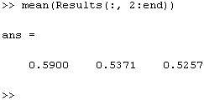
4 Functions
A function performs an operation on the input variable you pass to it
Passing variables is easy, you just list them within round brackets when you call the function
  function_Name(input)
You can also pass the function parts of a matrix
  >> function_Name(matrix(:, 1))
  or
  >> function_Name(matrix(:, 2:4))

Slide 53
4 Functions
The result of the function can be stored in a variable
  >> output_Variable = function_Name(input)
  e.g.
  >> mresult = mean(results)
You can also tell the function to store the result in parts of a matrix
  >> matrix(:, 5) = function_Name(matrix(:, 1:4))

Slide 54
4 Functions
To get help with using a function enter
  >> help function_Name
This will display information on how to use the function and what it does

Slide 55
4 Functions
MATLAB has many built in functions which make it easy to perform a variety of statistical operations
  sum – Sums the content of the variable passed
  prod – Multiplies the content of the variable passed
  mean – Calculates the mean of the variable passed
  median – Calculates the median of the variable passed
  mode – Calculates the Mode of the variable passed
  std – Calculates the standard deviation of the variable passed
  sqrt – Calculates the square root of the variable passed
  max – Finds the maximum of the data
  min – Finds the minimum of the data
  size – Gives the size of the variable passed
Notes:
Max, min, std []

Slide 56
4 Special functions
There are a number of special functions that provide useful constants
  pi = 3.14159265….
  i or j = square root of -1
  Inf = infinity
  NaN = not a number

Slide 57
4 Functions
Passing a vector to a function like sum, mean, std will calculate the property within the vector
  >> sum([1,2,3,4,5])
  = 15
  >> mean([1,2,3,4,5])
  = 3

Slide 58
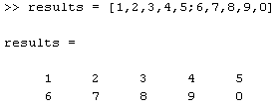



4 Functions
When passing matrices the property, by default, will be calculated over the columns

Slide 59
4 Functions
To change the direction of the calculation to the other dimension (columns) use:
  >> function_Name(input, 2)
When using std, max and min you need to write:
  >> function_Name(input, [], 2)

Slide 60
4 Functions
From Earlier
  >> results(:, 5) = results(:, 1) + results(:, 2) + results(:, 3) + results(:, 4)
  or
  >> results(:, 5) = results(:, 1) .* results(:, 2) .* results(:, 3) .* results(:, 4)
Can now be written
  >> results(:, 5) = sum(results(:, 1:4), 2)
  or
  >> results(:, 5) = prod(results(:, 1:4), 2)
Notes:
Due to the way std is written you need to add ,[]

Slide 61
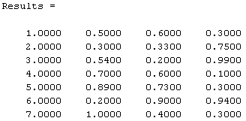
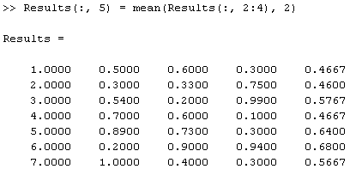
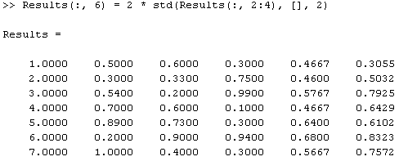
4 Functions
More usefully you can now take the mean and standard deviation of the data, and add them to the array

Slide 62
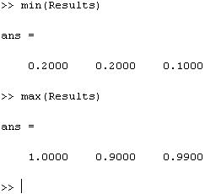
4 Functions
You can find the maximum and minimum of some data using the max and min functions
  >> max(results)
  >> min(results)

Slide 63
4 Functions
We can use functions and logical indexing to extract all the results for a subject that fall between 2 standard deviations of the mean
  >> r = results(:,1)
  >> ind = (r > mean(r) – 2*std(r)) & (r < mean(r) + 2*std(r))
  >> r(ind)

Slide 64
5 Plotting

Slide 65
5 Plotting
The plot function can be used in different ways:
  >> plot(data)
  >> plot(x, y)
  >> plot(data, ‘r.-’)
In the last example the line style is defined
    Colour: r, b, g, c, k, y etc.
    Point style: . + * x o > etc.
    Line style: - -- : .-
  Type ‘help plot’ for a full list of the options

Slide 66
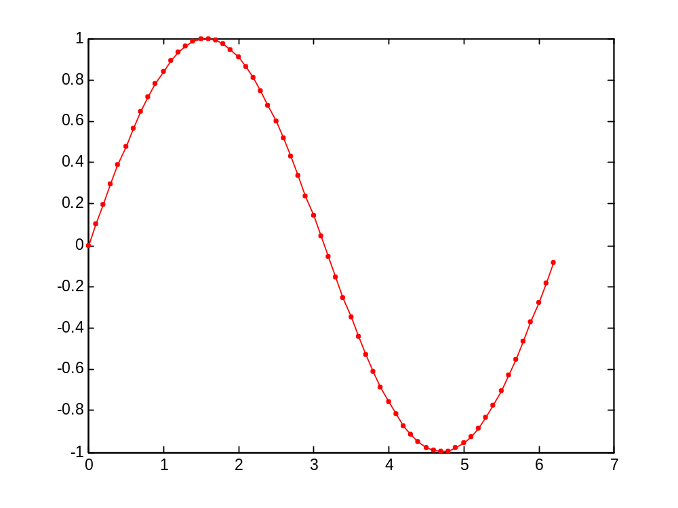
5 Plotting
A basic plot
  >> x = [0:0.1:2*pi]
  >> y = sin(x)
  >> plot(x, y, ‘r.-’)

Slide 67
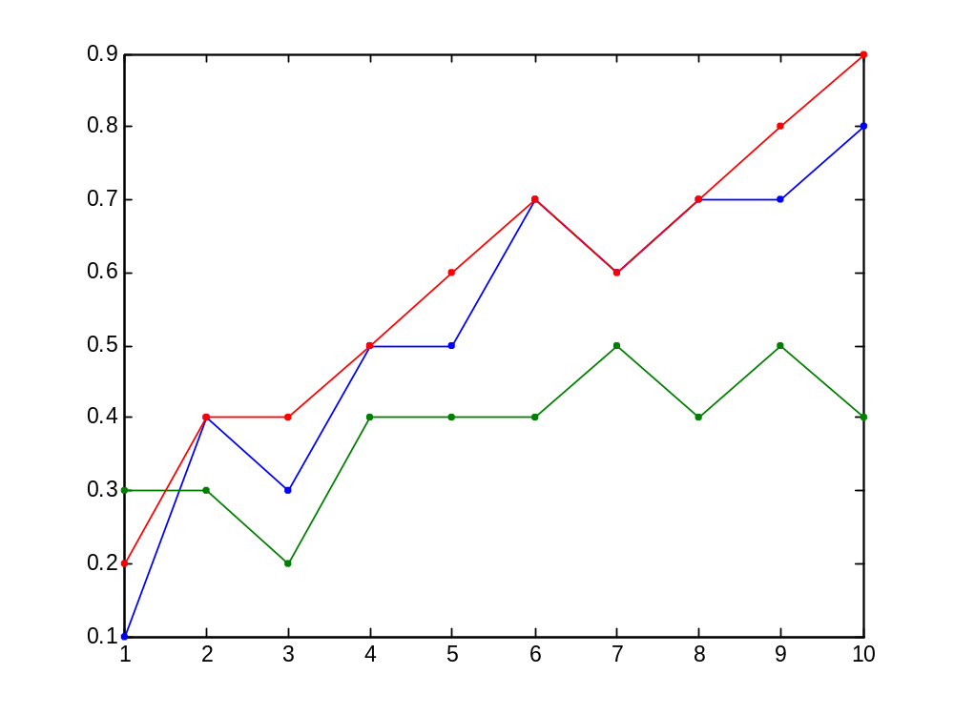

5 Plotting
Plotting a matrix
  MATLAB will treat each column as a different set of data

Slide 68
5 Plotting
Some other functions that are helpful to create plots:
  hold on and hold off
  title
  legend
  axis
  xlabel
  ylabel

Slide 69

5 Plotting
>> x = [0:0.1:2*pi];
>> y = sin(x);
>> plot(x, y, 'b*-')
>> hold on
>> plot(x, y*2, ‘r.-')
>> title('Sin Plots');
>> legend('sin(x)', '2*sin(x)');
>> axis([0 6.2 -2 2])
>> xlabel(‘x’);
>> ylabel(‘y’);
>> hold off
Notes:
Whenever entering text as input to title, legend or labels use ‘’ to enclose the text

Slide 70


5 Plotting
Plotting data
  >> results = rand(10, 3)
  >> plot(results, 'b*')
  >> hold on
  >> plot(mean(results, 2), ‘r.-’)

Slide 71

5 Plotting
  Error bar plot
    >> errorbar(mean(data, 2), std(data, [], 2))

Slide 72
5 Plotting
You can close all the current plots using ‘close all’

Slide 73
6 Save & load

